Slide 1
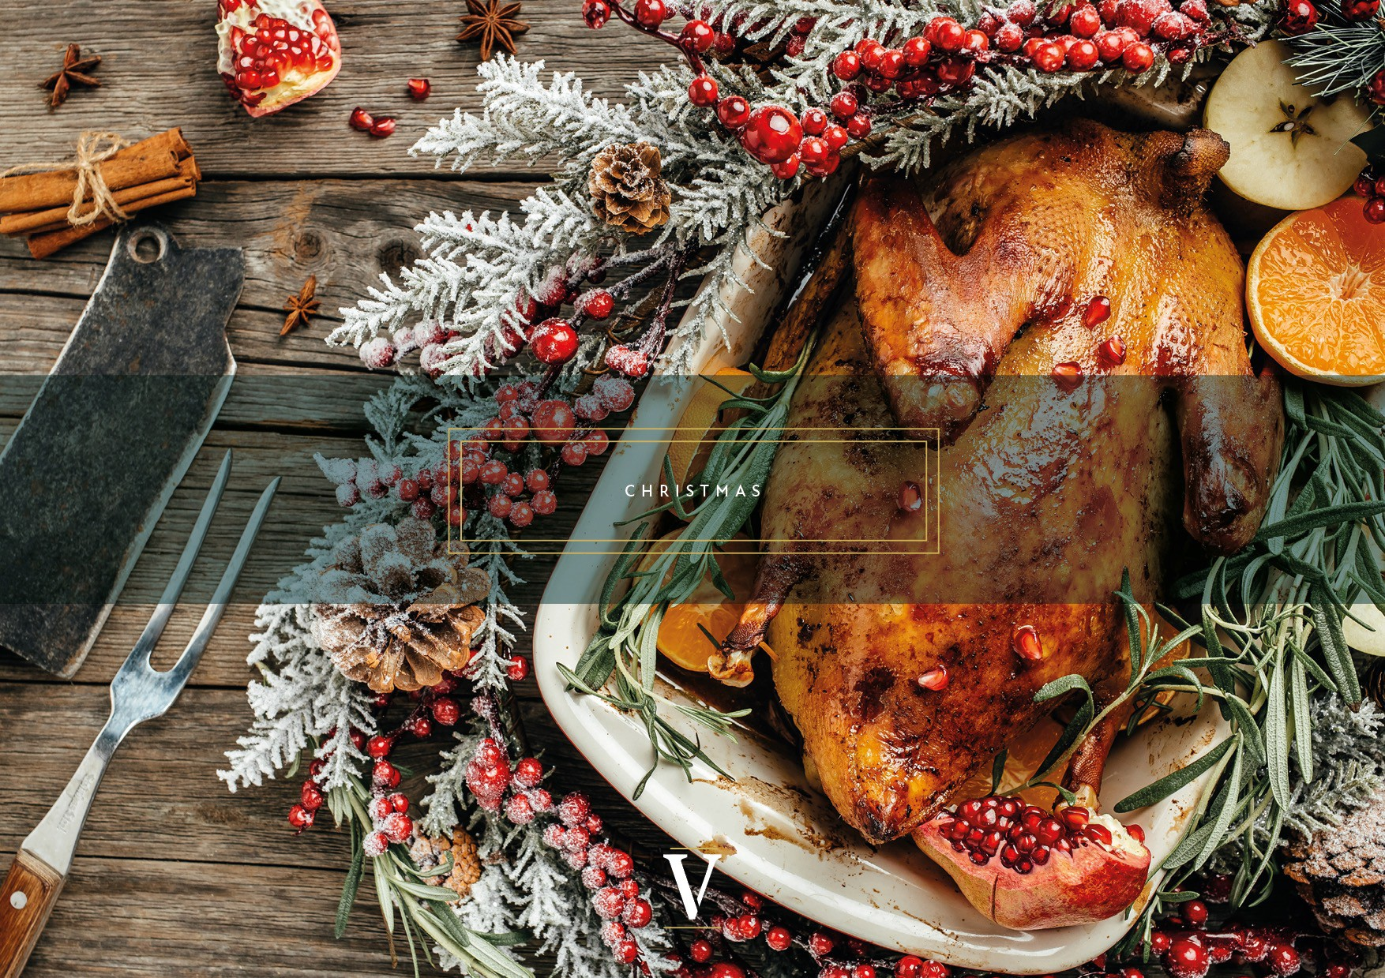

Slide 2
Christmas 2023
Two hours drinks reception
including
One glass of prosecco on arrival
Unlimited house wine and beer
Fruit juice and seasonal fizz
Still & Sparkling water
4 bowl food per person
Selection of nuts and snacks
***
£60.00 per person
(Min 20 guests)
Christmas drinks reception
Silver
Gold
Platinum
Three course dinner in our beautiful
Library
½ bottle of house wine per person*
Unlimited still and sparkling water
Unlimited juice and soft drinks
Christmas crackers
Cloakroom attendant
***
Catering from 80.00 per person
(Min 20 guests)
Standing reception in our Marble Hall and Gallery with sparkling prosecco and canapés followed by a three course sit down dinner in our beautiful Library
Prosecco reception (45min)
Three pre-dinner festive canapés
Three course dinner including:
Unlimited house wine*
Unlimited still and sparkling water
Unlimited juice and soft drinks
Christmas crackers
Cloakroom attendant
***
Catering from £99.50 per person
(Min 20 guests)
Three course dinner in our Library followed by a 2-hour drinks package in Marble Hall and Gallery
(total of 4h30min)
Three course dinner
Unlimited house wine* and beer
Unlimited still and sparkling water
Unlimited juice and soft drinks
Christmas crackers
Cloakroom attendant
***
Catering from £121.00 per person
(Min 20 guests)
(VE) Vegan / Plant-based
Vegetarian
(h) Healthy choice
*Upgraded wine available
For those with special dietary requirements or allergies who wish to know about the food and drink ingredients used, please ask the Event Coordinator
Please note room hire is not included in the menu prices.
All prices are per person and exclude VAT

Slide 3
Menus
Christmas canapes selection
Wild Mushroom & Chestnut Arancini, Truffle Mayo & Baby Cress (VE)
Spiced Bloody Mary Gazpacho, with Pico De Gallo Salsa (VE)
Crispy Taco, Green Pea Pannacotta, Olive & Mulled Wine Gel (VE)
Ashcombe & Pumpkin Tart, Sticky Date Jam & Micro Chive (V)
Hot Smoked Salmon, Beluga Caviar, Herb Bellini & Lemon Balm
Smoked Mackerel & Rillette, Irish Buttermilk Soda Bread, Dijon Mayo & Crispy Caper
Sashimi Tuna Tartare, Ponzu Gel, Pickled Chilli, Crispy Shallot, Nasturtium
Duck Liver Parfait, Sage Butter, Maderia, Toasted Brioche & Sea Salt
Rare Fillet of Beef, Horseradish Mousse, Caramelised Red Onion, Crispy Bruschetta
Tonka Bean & Strawberry Tartlet, White Chocolate & Citrus
Hazelnut Praline Filled Profiterole, Salted caramel & Cranberry Gel
(VE) Vegan / Plant-based
Vegetarian
(h) Healthy choice
*Upgraded wine available
For those with special dietary requirements or allergies who wish to know about the food and drink ingredients used, please ask the Event Coordinator
Please note room hire is not included in the menu prices.
All prices are per person and exclude VAT

Slide 4
Menus
Festive bowl food
Mini mushroom and caramelised red onion wellington, celeriac puree & thyme jus (V)
Crispy basil tofu, chop suey noodles, black garlic & pink ginger (V)
red miso salmon, sticky rice, nigella seed, shiso cress
smoked haddock, creamed leeks, chestnut, celeriac & sage
Gressingham turkey, pancetta, thyme, brown butter mash, porcini jus
Crispy beef, vermicelli noodles, black bean sauce, sesame
Stem gingerbread, salted caramel, rum & clotted cream
White chocolate, pecan crumble, sticky date & cherry
(VE) Vegan / Plant-based
Vegetarian
(h) Healthy choice
*Upgraded wine available
For those with special dietary requirements or allergies who wish to know about the food and drink ingredients used, please ask the Event Coordinator
Please note room hire is not included in the menu prices.
All prices are per person and exclude VAT

Slide 5
Menus
Xmas fine dining
Starters
Caramelised cauliflower velouté, chestnut, maple & truffle (V)
Winter mushroom ravioli, artichoke puree, lovage & parsnip crisp (VE)
Pan seared king scallop, garlic beurre noisette, celeriac puree & chive oil
Bourbon cured salmon, smoked duck egg dressing, soda bread & dill
Wild boar ravioli, pumpkin, parmesan cream, crispy sage
Chicken liver parfait, sable biscuit, cherry gel & cognac butter
Mains
Black truffle & king oyster mushroom risotto, chervil, pinot & lemon thyme (V)
Pan seared cauliflower, spiced cabbage puree, sprout tops, swede & artichoke crisp. (VE)
Butter basted hake fillet, soubise, saffron emulsion, samphire & Yukon potato
Gressingham duck breast, dauphinoise bon bon, tenderstem, confit carrot puree, black cabbage crisp & bordelaise
Turkey & chestnut ballotine, duck fat roasties, cauli cheese puree, bbq leeks & bone marrow jus
(VE) Vegan / Plant-based
Vegetarian
(h) Healthy choice
*Upgraded wine available
For those with special dietary requirements or allergies who wish to know about the food and drink ingredients used, please ask the Event Coordinator
Please note room hire is not included in the menu prices.
All prices are per person and exclude VAT

Slide 6
Menus
Desserts
Milk chocolate dome, Macha sponge, winter berry, champagne sabayon
Tonka bean Brulle bar, shortbread, toffee sauce & raspberry gel
Lemon verbena pannacotta, mulled wine compote, pistachio
Sticky toffee pudding, hazelnut praline, Maldon ice cream (VE)
(VE) Vegan / Plant-based
Vegetarian
(h) Healthy choice
*Upgraded wine available
For those with special dietary requirements or allergies who wish to know about the food and drink ingredients used, please ask the Event Coordinator
Please note room hire is not included in the menu prices.
All prices are per person and exclude VAT

Slide 7
t
ALLERGEN INFORMATION
Do you have a food allergy or intolerance? We provide allergen information on the 14 major allergens.
@
MOLLUSCS
09
NUTS
LUPIN
MUSTARD
Please speak with your event manager or sales executive, and details of allergens in any of our dishes can be provided for your consideration.
\)
PEANUTS
0
EGG
At your event there will be an 'Allergen Folder' available at all buffet stations on your event catering floor / area should you or your guests have any questions on the day.
Please note, as with every catering establishment, there is always a potential for cross-contamination to occur.While we endeavour to prevent this as far as possible, the nature of an allergen means we cannot fully guarantee that cross-contamination may not have occurred.We encourage our customers with food allergies and intolerances to let our staff know, so we can better cater for them.We are happy to provide further detail on ingredients and how they were handled to allow you make an informed decision as to whether the food is suitable for you.
CRUSTACEANS FISH
A
SULPHUR DIOXIDE SOYBEAN
& SULPHITES
[)
MILK
CELERY
C>OO
SESAME
CEREALS CONTAINING GLUTEN
i f you have any concerns
,,
PLEASE SPEAK TO A MEMBER OF STAFF

